Slide 1
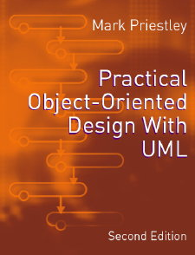
PRACTICAL
OBJECT-ORIENTED
DESIGN WITH UML
2e
Chapter 6:
Restaurant System: Design

Slide 2
Design
Analysis shows how business functions can be implemented in the application layer
Design extends this level of modelling to the other layers
We assume the booking system will be implemented as a desktop application, ie:
  single user
  normal input and output devices

Slide 3
Getting Input From The User
System messages have been shown arriving at the controller in the application layer
In fact these will have been ‘pre-processed’ in presentation layer
A boundary object in the presentation layer models the system's user interface
This has the responsibility for interacting with input devices

Slide 4
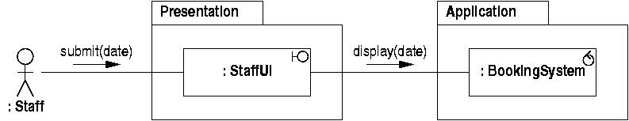
Display Bookings
Assume date is entered in a dialogue box
  don't need to model standard dialogue box functionality in detail
  ‘submit’ message models pressing ‘OK’ button

Slide 5
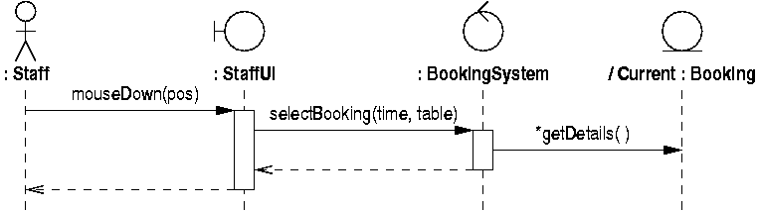
Selecting a Booking
Mouse events are handled similarly
  user interface object translates mouse events into system messages
  ‘time’ and ‘table’ derived from mouse coordinates

Slide 6
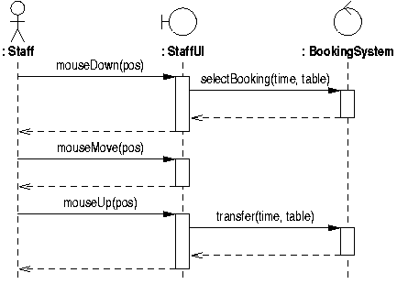
Table Transfer
Not every input event need give rise to a system message

Slide 7
Producing Output
Output also assigned as a responsibility of the user interface object
The display should be updated whenever the application layer changes
Problem: how to ensure that the display is:
  always updated when it needs to be
  only updated when it needs to be

Slide 8
Polling
The presentation layer would periodically check the application layer for updates
  wasteful of processing time
  expensive to tell if something has changed
Better if the application layer triggered updates in the presentation layer
  but how? In the layered architecture, the presentation layer is supposed to be independent of the application layer

Slide 9
Observer Pattern
Design patterns are standard solutions to problems like this
In particular, the Observer pattern:
  allows changes to one object (eg application) to be communicated to others (eg presentation)
  without assuming what the other objects are
This will allow the application layer to trigger events in the presentation layer

Slide 10
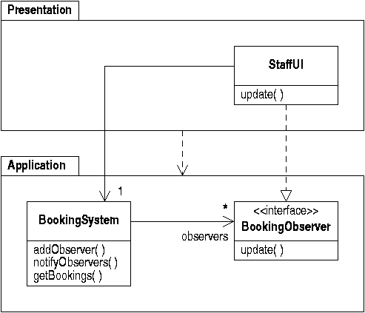
Observer Pattern Structure

Slide 11
Interfaces in UML
Interfaces are represented as stereotyped classes
  they have operations but no attributes
Classes can realize interfaces
  shown as a dashed arrow with an open arrowhead from the class to the interface
  this means the class must implement all the operations defined in the interface

Slide 12
Observer Pattern Rationale
The user interface class implements the booking observer interface
The booking system maintains a list of registered observers
  but it doesn't know what class they belong to
  so there is no 'upwards' dependency
Each observer is notified whenever a change takes place

Slide 13
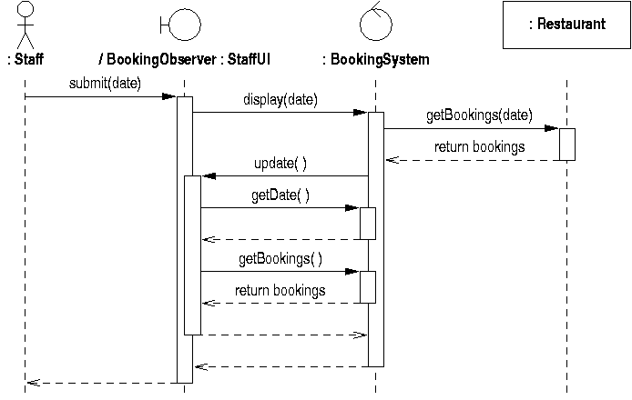
Displaying bookings

Slide 14
Explanation
The interface implemented by the ‘StaffUI’ object is shown as a role
When something changes, the ‘update’ messages is sent to the user interface
It then gets updated information from the booking system
  the simplest option is to redisplay everything
  this can be optimized later if necessary

Slide 15
Persistent Data
Most systems need persistent data which is
  not lost when the system closes down
  stored in file system or database
Object-oriented applications often use relational databases to provide persistence
Designer needs to:
  identify what data needs to be persistent
  design a suitable database schema

Slide 16
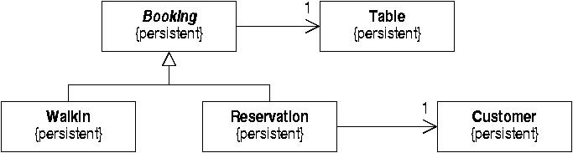
Designating Persistent Classes
In UML classes are the unit of persistence
  we must save all booking information
  but not eg current date, or selected bookings
Persistence is shown using a tagged value

Slide 17
Creating a Database Schema
Classes map to tables
Associations are relationships between tables, so:
  add explicit object IDs to each table
  use these as foreign keys to implement links
Generalization has no relational equivalent
  as ‘Booking’ is an abstract class, simply map concrete subclasses as tables

Slide 18
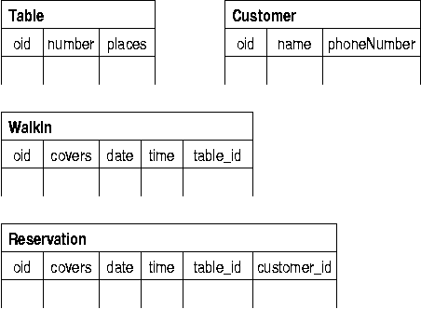
Database Schema
From this we can derive a simple schema

Slide 19
Saving and Loading
Whose responsibility is it to save objects and load them from the database?
  using existing classes risks low cohesion
  make this the responsiblity of a new class
  define a ‘mapper’ class for each persistent class
Include object IDs in design model
  keep persistency out of domain model classes
  add ‘oids’ in a subclass

Slide 20
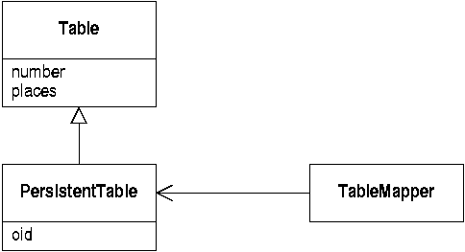
Design for Persistency
The mapper classes deal with the persistent subclasses

Slide 21
Persistency Architecture
Persistent subclasses and mapper classes depend on the class they are supporting
  so they must be in the application layer
But the ‘Restaurant’ class is dependent on mapper classes
Split application layer into two subpackages
  change to ‘Persistency’ subpackage has minimal effect on ‘Domain’ subpackage

Slide 22
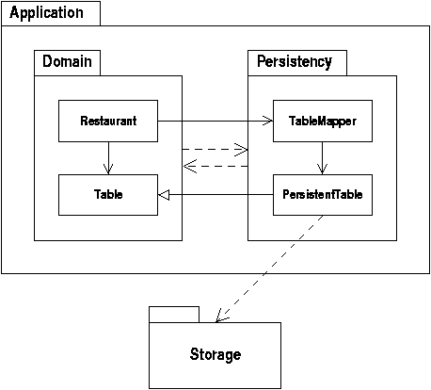
Persistency Architecture

Slide 23
Detailed Class Design
Create a detailed class specification that could be used as a basis for implementation
Start with refined domain model
Collect messages from all realizations
  check redundancy, inconsistency etc
  this defines the operation interface of class
  specify detailed parameters and return types

Slide 24
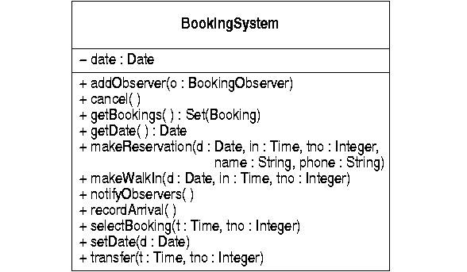
The Booking System Class

Slide 25
Modelling Behaviour
Class diagrams show structural design
Sequence diagrams show behaviour
But some questions are not answered, eg:
  what should the system do if a ‘cancel’ message is received before a booking is selected?
  what happens if the user tries to move a cancelled booking from one table to another?
These depend on the interaction between separate messages

Slide 26
Statecharts
Summarize the behaviour of instances of a single class
They answer two types of question:
  what sequences of messages the objects are expected to receive and respond to
  how an object's response to a message depends on its history, ie the messages that have already been received
Not every class will require a statechart

Slide 27
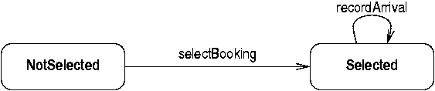
Booking System Statechart
The behaviour of the booking system is different if a booking is selected
This suggests that it has (at least) two states

Slide 28
Basic Statechart Properties
At any given time, an object is in exactly one of a number of states
When a message is received, a transition will fire if:
  there is a transition leaving the current state
  labelled with an event corresponding to the message
The object may then end up in a different state

Slide 29
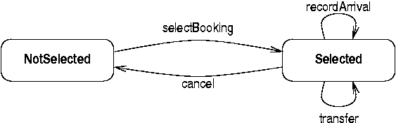
Operations on Bookings
Further transitions can be added for all the events an object can detect

Slide 30
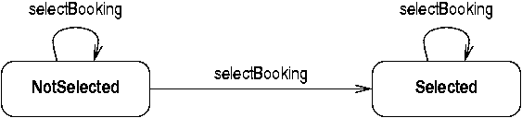
Nondeterminism
Sometimes an event can have more than one transition
For example, the user may try to select a booking with the mouse over empty space
  nothing will be selected and the state will not change

Slide 31
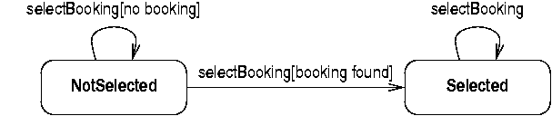
Guard Conditions
Nondeterminism can be removed using guard conditions
  these are Boolean expressions stating when each transition will fire

Slide 32
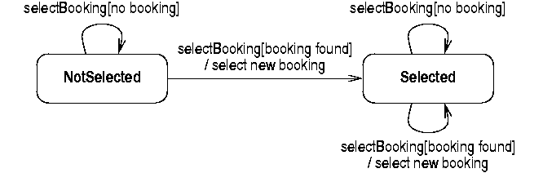
Actions
Statecharts can show what an object does in response to a particular event
These are shown as actions attached to the relevant transition

Slide 33
Composite States
Composite states can simplify diagrams
  they define properties shared by all the ‘nested’ states
Transitions can freely cross the boundary
Transitions from a composite state apply to all the nested states
History states ‘remember’ the most recent nested state
  a transition to a history state goes to that state

Slide 34
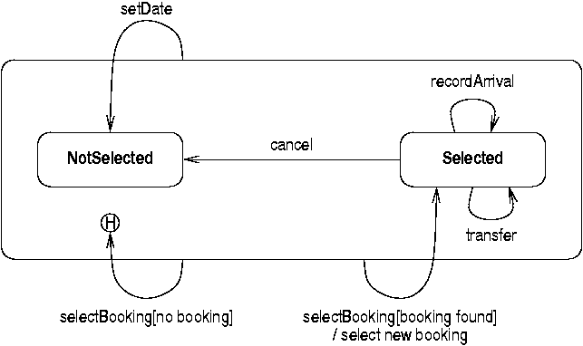
Booking System Statechart

Slide 35
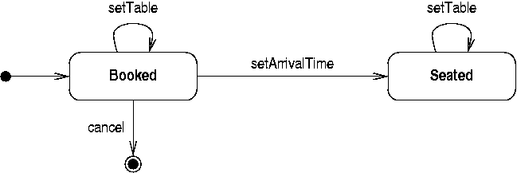
Reservation Statechart
Reservations have different behaviour after the diners have arrived
  can't then cancel the reservation

Slide 36
Initial and Final States
Initial states model object creation
  a transition from an initial state corresponds to a constructor
  but: initial states inside composites indicate what state a transition ending at the composite will end up at
Final states model object destruction
  once an object reaches a final state it cannot detect events

Slide 37
Error Handling
An object may detect an event when there is no matching transition from its current state
UML specifies that event is simply ignored
In some cases, this indicates an error
  to show this, add an explicit ‘Error’ state
  add transitions to specify how the system recovers from the error

